Slide 1
HYDROCLIMATOLOGY · LOWER MISSISSIPPI
Precipitation as a predictor of flow extremes at Tarbert Landing
An out-of-sample classification and analog-composite analysis of Mississippi River discharge (1930–2026) from basin precipitation over six contributing sub-basins (1901–2024).
Methods and interpretation

Slide 2
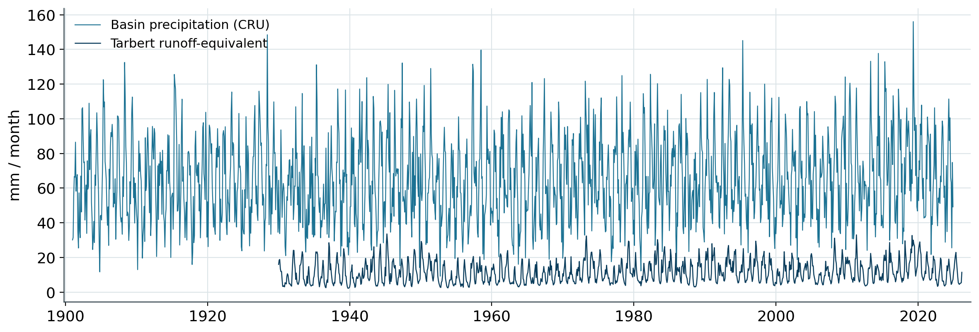
OBJECTIVE & DATA
Question, data, and design
To what extent is basin precipitation alone sufficient to discriminate the flood and drought extremes of Mississippi discharge at its lowermost gauge?
Coupled precipitation and discharge records
1
Extremes defined per calendar month
High-flow months are the upper 5%, and low-flow the lower 10%, of each calendar month's discharge relative to 1930–1989. Conditioning on month removes the seasonal cycle.
2
Precipitation scored by discrimination
Basin precipitation is accumulated over 1–36-month windows, ranked against climatology, and evaluated by AUC — the separation it achieves between extreme and ordinary months.
Basin precipitation (teal) and Tarbert runoff-equivalent (navy), 1930–2024. The evident covariation is the premise the analysis renders quantitative.
3
Strict out-of-sample validation
1,140 overlapping months · >99.9% grid coverage · 6 contributing sub-basins
Estimation uses 1930–1989; evaluation uses 1990–2024 (420 withheld months). All reported skill is out-of-sample unless otherwise noted.
Tarbert Landing · CRU precipitation study
2

Slide 3
METHOD · THE MODEL
The predictive model
The reported skill is produced by a precipitation-only logistic regression — a classifier estimating the probability that a given month is an extreme.
Inputs — precipitation only
Logistic regression
Output — monthly probability
≈120 features: basin-total and per-sub-basin rainfall accumulated over 1–36 months at 0–6-month lags, each expressed as a calendar-month percentile.
>
A weighted sum of the features is passed through the logistic (S-shaped) function to return a probability. Inputs standardized, classes balanced, coefficients regularized.
>
P(flood) and P(drought) per month, in [0,1]. Two independent models, one per tail. Discrimination scored by AUC on withheld years.
Estimated on 1930–1989 (720 months) · evaluated on 1990–2024 (420 months withheld from estimation)
Two complementary tools. The logistic model, combining all features simultaneously, yields the headline discrimination (AUC 0.95 drought, 0.87 flood). The mechanism, memory, and sub-basin results that follow are instead obtained from a single-metric screen — ranking one precipitation accumulation at a time — which is more transparent and less prone to overfitting. The two are in agreement, and the single-metric screen is therefore treated as the robust estimate; the logistic model's near-perfect training scores are interpreted with corresponding caution (Slide 14).
Tarbert Landing · CRU precipitation study
3

Slide 4
PRINCIPAL RESULT
Precipitation discriminates both flow extremes out of sample
Out-of-sample discrimination of extreme months, 1990–2024, from the precipitation-only model.
DROUGHT (LOW FLOW)
FLOOD (HIGH FLOW)
0.95
0.87
test AUC
test AUC
The low-flow tail is discriminated most sharply.
The high-flow tail is discriminated well, though less sharply.
AUC — area under the ROC curve. The probability that a randomly selected extreme month is assigned a higher precipitation-based score than a randomly selected ordinary month; 1.0 denotes perfect separation, 0.5 no skill. Both tails are discriminated well, the low-flow tail more sharply than the high-flow tail.
Tarbert Landing · CRU precipitation study
4

Slide 5
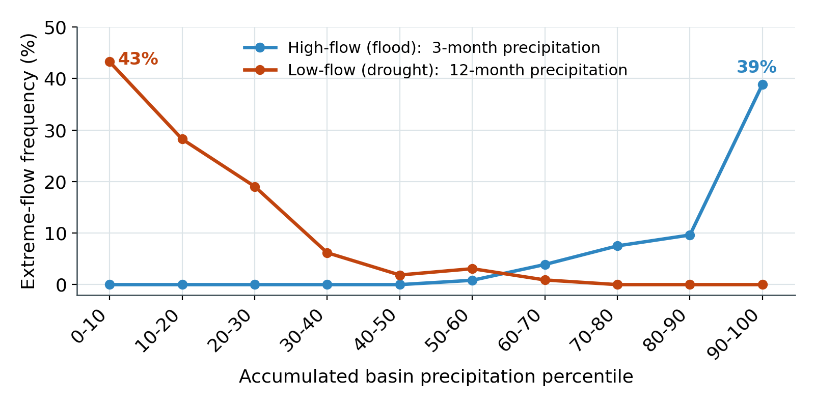
MECHANISM
A monotonic dose-response across the tails
Accumulated-precipitation percentile relates monotonically, and oppositely, to the frequency of each extreme.
LOWEST 10%
~43%
of months in the driest precipitation decile are low-flow; none are high-flow.
HIGHEST 10%
~39%
of months in the wettest decile are high-flow; none are low-flow.
The curves intersect near the median, where precipitation is minimally informative.
Tarbert Landing · CRU precipitation study
5

Slide 6
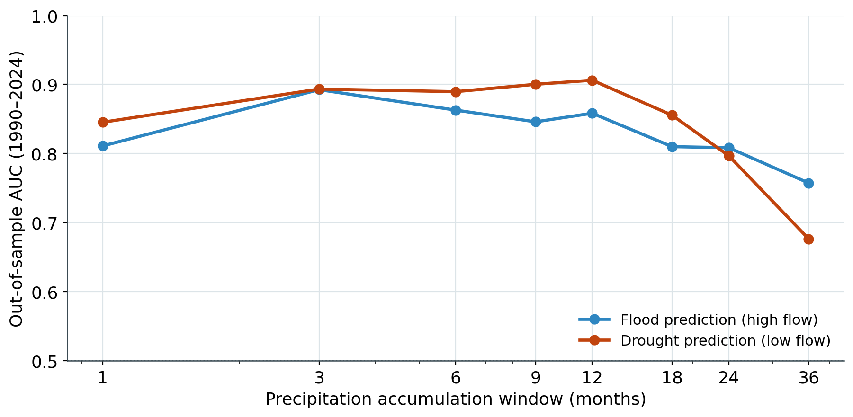
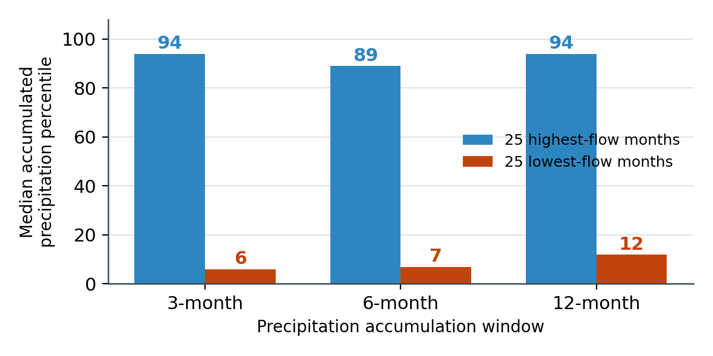
MECHANISM · TIMESCALE
Distinct precipitation memory in the two tails
The tails are governed by precipitation over different timescales, which underlies their differing predictability.
Discrimination by accumulation window
Accumulated precipitation percentile of the 25 most extreme months
High-flow discrimination peaks sharply at a 3-month window, indicating a rapid, near-term response; low-flow discrimination is maximized near 12 months, indicating a cumulative deficit.
Both tails carry a strong precipitation signal: the wettest months follow precipitation near the 94th percentile, the driest near the 6th. The asymmetry is one of timescale, with floods are 3-month totals and drought 12-month totals.
Tarbert Landing · CRU precipitation study
6

Slide 7
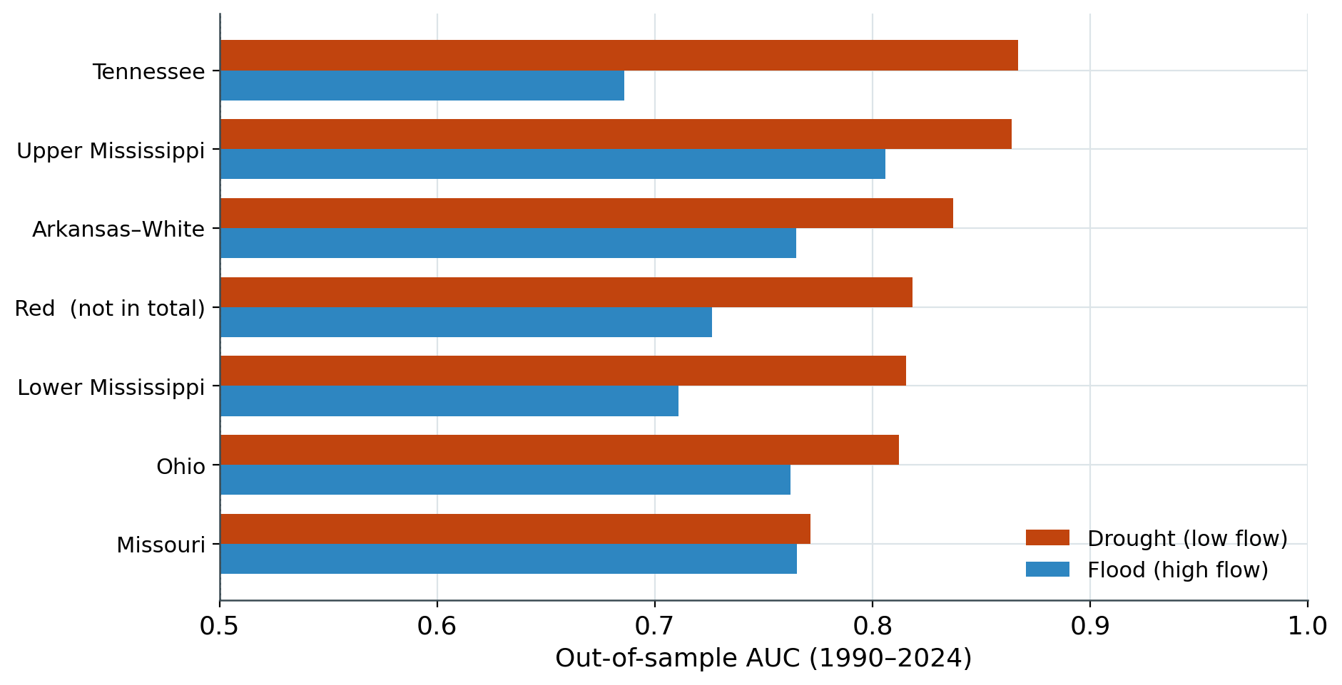
SPATIAL STRUCTURE
Spatial coherence distinguishes the two extremes
Scoring each sub-basin independently localizes where each extreme is generated.
Drought is basin-wide
All six contributing basins carry strong low-flow discrimination (AUC 0.77–0.87). Sub-normal precipitation is spatially coherent — the system is dry as a whole.
Floods are upper-basin-weighted
High-flow discrimination is led by the Upper Mississippi (0.81) and weakest in the Tennessee (0.69). Flood generation is more localized and fast-routing.
An internal consistency check
The Red River — excluded from the Tarbert total — nonetheless tracks the extremes, indicating the signal is regional climate rather than a gauge artifact.
Tarbert Landing · CRU precipitation study
7

Slide 8
BOUNDARY OF THE SIGNAL
Skill concentrates in the tails, not the interior
Precipitation governs the extremes; it explains ordinary month-to-month variation only moderately.
Sources of interior attenuation
In the tails
Across all months
Storage and routing — snowpack and channel travel time redistribute precipitation in time
0.87–0.95
≈ 0.6
Reservoir and navigation management — regulated releases decouple flow from weather
AUC on flood and drought months — precipitation dominates.
Rank correlation of precipitation with monthly flow — moderate only.
Evapotranspiration — the runoff ratio varies with temperature and demand
Monthly aggregation — conceals the sub-monthly bursts that generate some floods
These processes are precisely what a fuller land-surface model would add; precipitation is the first-order control on which they act.
Tarbert Landing · CRU precipitation study
8

Slide 9
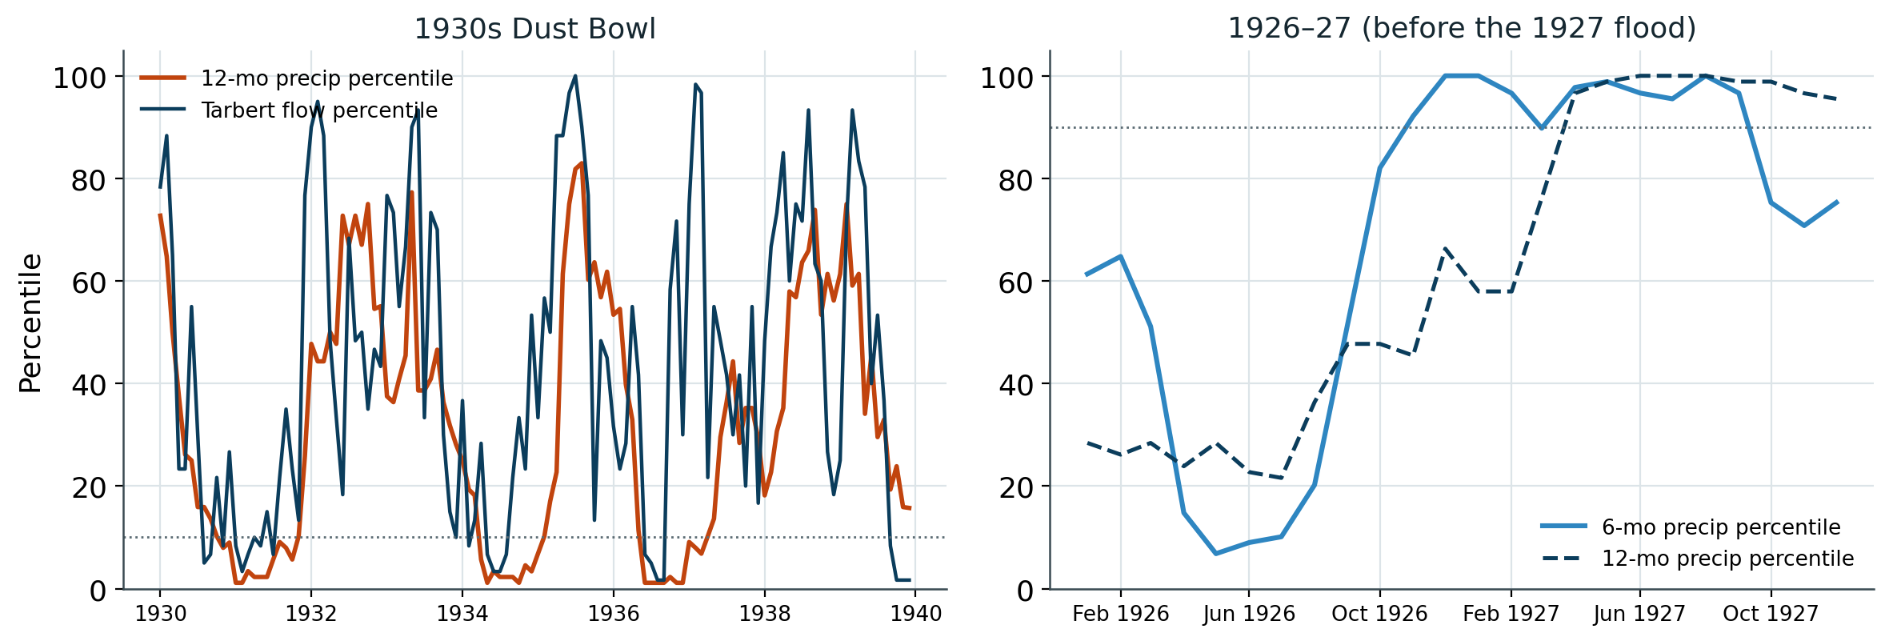
EXTERNAL CORROBORATION
Corroboration by the century's principal extremes
Calibrated on statistics rather than on historical knowledge, the framework reproduces the two defining twentieth-century events.
Dust Bowl: multi-year precipitation reached the ~1st percentile and flow followed; the 1930s contain 23 of the record's low-flow months — its driest decade.
1927 flood: 6- and 12-month precipitation preceding the event reached the 100th percentile — the framework would have indicated extreme flood risk.
Tarbert Landing · CRU precipitation study
9

Slide 10
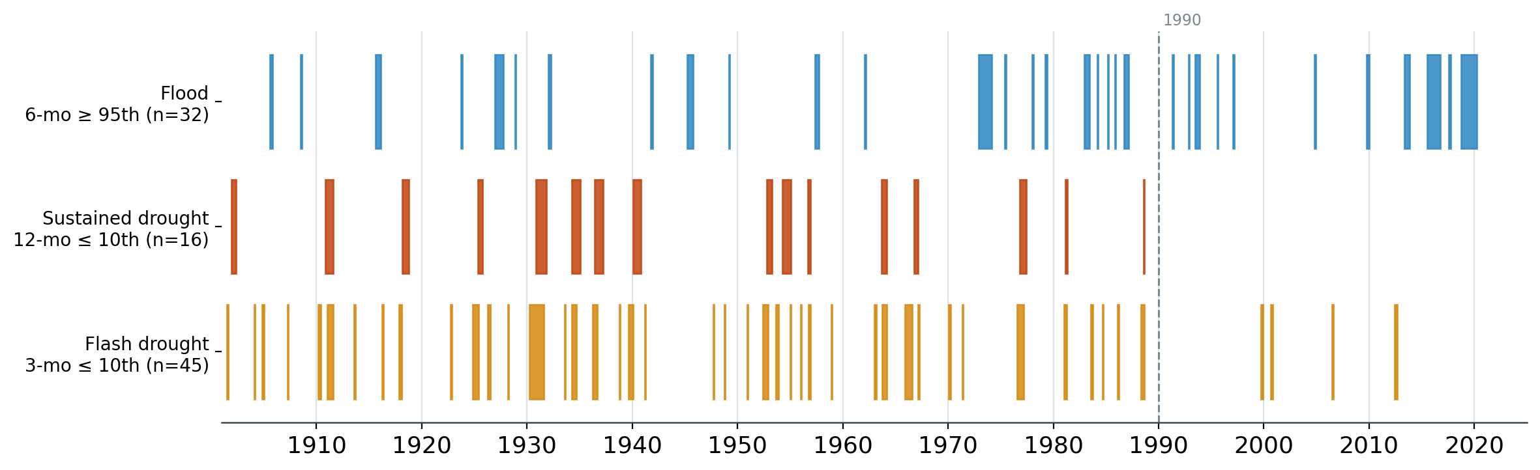
ANALOG COMPOSITING · SELECTION
Event-class compositing: analog selection
The extremes are treated as event classes and their analogs drawn across 1901–2024. Because the tails occupy distinct timescales, each class is sampled with its own accumulation window and percentile threshold; the drought tail is resolved into two regimes (Slide 12).
Selection parameters
Declustering & anchoring
Flood — 6-mo, ≥ 95th pct → 32 episodes.
Sustained drought — 12-mo, ≤ 10th pct → 16 episodes.
Flash drought — 3-mo, ≤ 10th pct → 45 episodes.
Consecutive exceedances are collapsed to single episodes to enforce independence. Drought thresholds match the 10th-percentile low-flow definition. Both targets qualify decisively: the 1927 flood reaches the 100th percentile at 6 months; every Dust Bowl year the 1st at 12 months.
Tarbert Landing · CRU precipitation study
10

Slide 11
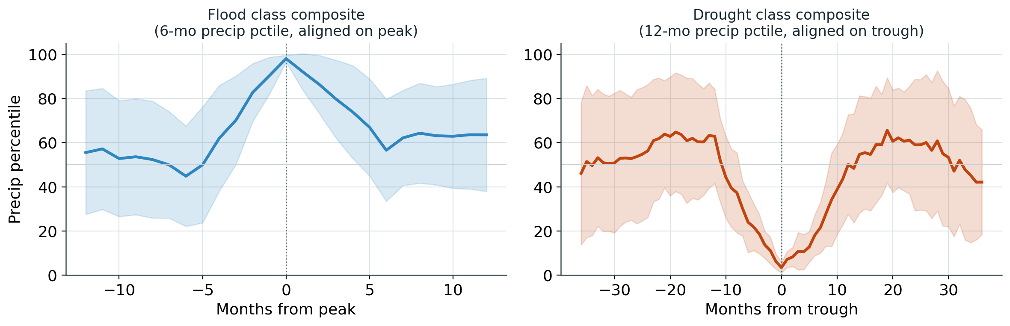
ANALOG COMPOSITING · CONSTRUCTION
Class-mean precursor structure
Analogs are pooled to estimate the class-mean precursor. Episodes are aligned on the peak (flood) or trough (drought) of the selection metric, superposing onset and recession.
Quantities composited
(i) Sub-basin percentiles
The seven sub-basin fields, resolving the spatial signature of each class.
(ii) Lead–lag evolution
The selection metric over a window matched to each class's memory.
(iii) Tarbert runoff
The composites confirm the timescale asymmetry empirically: the flood class builds and recedes within ~6 months; the sustained-drought class onsets and recovers over >20 months. Shading is ±1 SD across episodes.
Flow percentile (post-1930), confirming coincidence with a realized flow extreme.
Uncertainty. Assessed against climatological resampling; drought intervals are wider, reflecting the smaller, physically limited episode population.
Tarbert Landing · CRU precipitation study
11

Slide 12
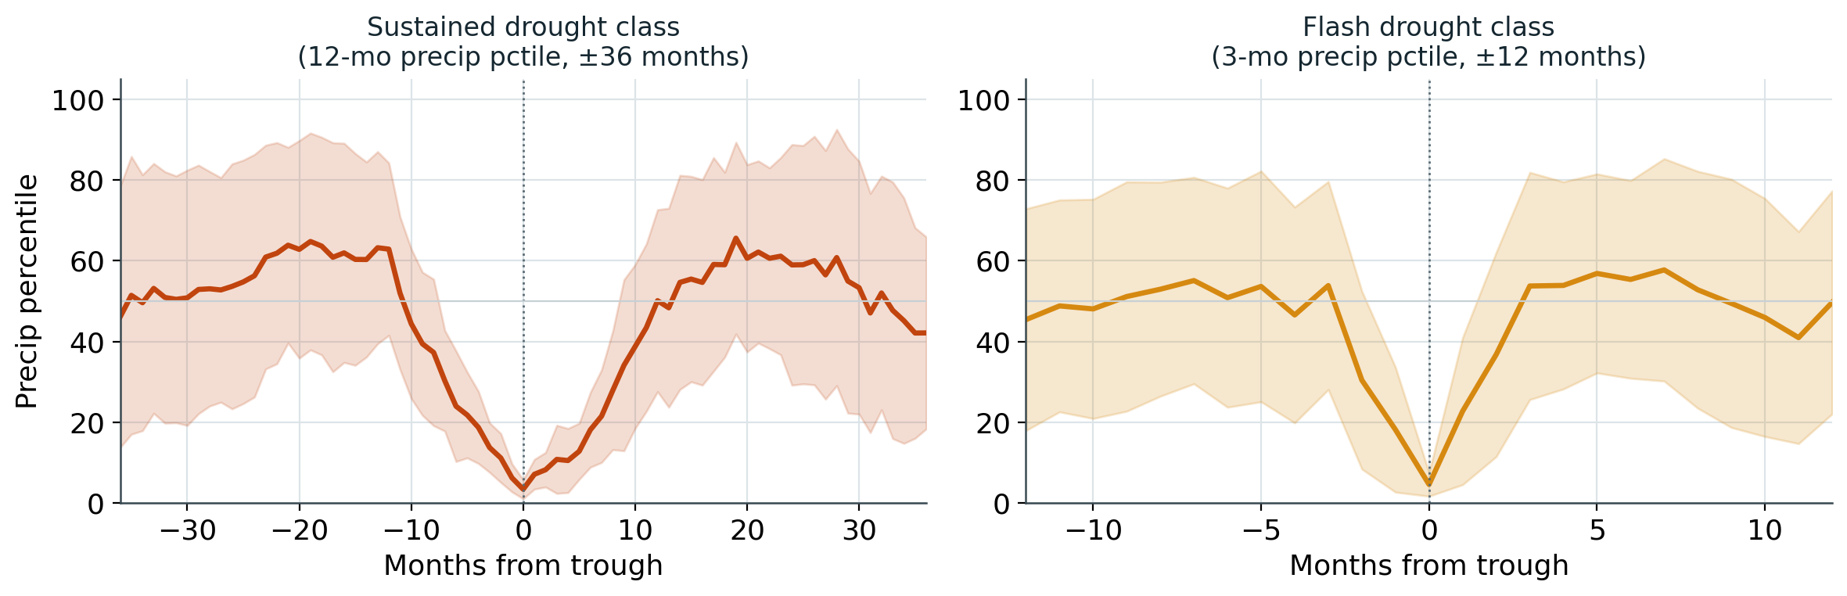
INTERPRETATION · DROUGHT REGIMES
Two drought regimes: sustained and flash
Resolving the drought tail by timescale reveals two physically distinct regimes with markedly different temporal distributions.
The temporal split
Sustained: 16 episodes, none after 1988.
Flash: 45 episodes, 41 before 1990 and 4 after (1999–2012).
What it means
Baseline non-stationarity
Against the 1901–1989 climatology the basin has since run wetter (recent median ≈ 78th pctile), so sustained deficits scarcely register.
Sustained droughts (12-month deficits) exhibit a broad ~20-month trough; flash droughts (3-month deficits) a sharp trough of a few months. The 2023 record-low-water event lies outside both classes, as basin-total precipitation was near-normal (Slide 13).
A shift in drought character
Recent low flows follow short (2–4 month) deficits, not multi-year ones; the modern regime is flash-type.
A window-dependent blind spot
The 12-month lens optimal for the historical regime cannot detect the droughts that occur now.
Tarbert Landing · CRU precipitation study
12

Slide 13
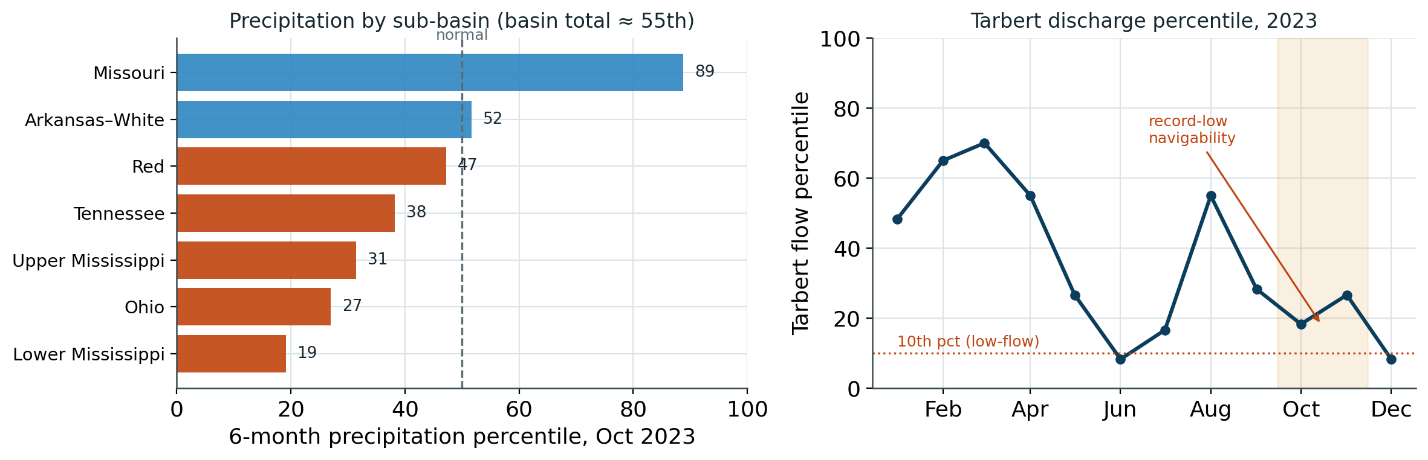
INTERPRETATION · A DECISIVE CASE
Agricultural and navigation drought are distinct events
2023 is a critical case: near-normal basin precipitation coincided with a record national crop and record-low river navigability — low water without an agricultural drought.
BASIN PRECIPITATION
near-normal
total ≈ 55th percentile — no basin-wide drought
2023 U.S. CORN CROP
record ≈ 15.3 Bbu
a national record, harvested that autumn
MISSISSIPPI AT MEMPHIS
record low
Precipitation in 2023 was spatially heterogeneous but near-normal in aggregate (basin total ≈ 55th percentile); discharge at Tarbert nonetheless fell to the 8th–18th percentile through the autumn shipping season.
−11.91 ft (Oct 2023), second year running
Implication
Low navigability and grain volume can peak together. Navigation drought is set by basin-integrated flow, not Corn-Belt growing-season moisture — so the hazard cannot be assumed to self-correct through reduced crop supply.
Tarbert Landing · CRU precipitation study
13

Slide 14
LIMITATIONS
Limitations
Five constraints that bound the interpretation of the reported skill.
!
Sparse out-of-sample droughts
!
Multi-feature overfitting
The 0.95 low-flow AUC rests on only 12 withheld drought months; its confidence interval is correspondingly wide.
The logistic model attains ~0.99 in training and declines out of sample; the robust estimate is the single-metric screen (~0.86–0.90), with which it agrees.
!
Precipitation-only formulation
!
Baseline non-stationarity
Snowpack, soil moisture, reservoir operations, and evaporation are excluded by design; their omission bounds the precision of any single-month estimate.
Percentiles referenced to 1901–1989 understate recent dryness; a rolling or detrended baseline would be required to characterize contemporary droughts.
!
Monthly resolution
CRU is a smoothed monthly grid (coverage >99.9%); sub-monthly bursts driving flash floods are unresolved.
Tarbert Landing · CRU precipitation study
14

Slide 15
CONCLUSIONS
Conclusions
Basin-averaged precipitation is a strong, physically interpretable, out-of-sample predictor of Mississippi flow extremes at Tarbert.
Droughts are the more predictable tail
Long-memory and spatially coherent; the AUC of 0.95 reflects the cumulative, basin-wide nature of precipitation deficits.
Floods are discriminated well but less sharply
Short-memory and upper-basin-weighted; an AUC of 0.87 is limited by sub-monthly bursts, snowmelt, and routing.
Drought comprises two regimes
A sustained (historical) and a flash (contemporary) regime; against a fixed baseline the sustained type has not recurred since 1988, and recent low flow is flash-driven.
A baseline for land-surface models
Adding soil moisture, snowpack, and reservoir state should sharpen the interior; a rolling baseline is required to track modern drought.
Tarbert Landing · CRU precipitation study
15

