Slide 1
ERA5 REANALYSIS | 1959-2024, WITH POST-1940 ANALOGS
Atmospheric Moisture-Budget Origins of
Mississippi River Wet and Dry Extremes
Diagnosing how the atmosphere supplies moisture during extreme 3-month wet sequences and withholds it during persistent 12-month droughts, and building a physical bridge to the 1927 Mississippi flood.
0.952 monthly P-E vs convergence 27 / 17 wet / dry episodes 7 sub-basins
Independent ERA5 P, E, moisture-flux divergence and vapour-transport products | 1940-2024 mean-flow / transient decomposition

Slide 2
OBJECTIVE
Beyond a precipitation-only view of hydroclimate extremes
The precipitation record tells us WHEN extremes happen. The moisture budget tells us HOW the atmosphere produces them. Five questions frame the analysis:
01
SUPPLY
How is moisture supplied during extreme 3-month wet sequences?
02
FAILURE
Do 12-month droughts reflect a sustained failure of moisture convergence?
03
REGIME
Are extremes driven by the monthly-mean circulation or by transient weather systems?
04
MECHANISM
Within the mean flow, is it wind-field convergence or horizontal moisture advection?
05
CHANGE
Have the frequency or character of these regimes shifted across the ERA5 era?
ERA5 moisture-budget analysis | Mississippi River wet and dry extremes
2

Slide 3
STUDY DOMAIN
Seven sub-basins, one Tarbert drainage definition
Basin roster
Why six define the events
Upper Mississippi
Tarbert-contributing
The Tarbert-wide precipitation index uses only the six basins that actually contribute flow at Tarbert Landing. Red River is deliberately excluded from that drainage total so the event definition matches the streamflow it is meant to explain.
Missouri
Tarbert-contributing
Ohio
Tarbert-contributing
Tennessee
Tarbert-contributing
Arkansas-White
Tarbert-contributing
Why Red stays in
Lower Mississippi
Tarbert-contributing
Red River is kept as a seventh regional diagnostic. It reveals whether a moisture anomaly is confined to the Tarbert drainage or reflects a broader south-central pattern. Grid cells come from basin polygons; spatial means are cosine-of-latitude weighted.
Red River
Regional diagnostic
ERA5 moisture-budget analysis | Mississippi River wet and dry extremes
3

Slide 4
ERA5 VARIABLES
Fields and sign conventions
P
E
C
Q
Precipitation
Upward evaporation
Moisture convergence
Vapour transport
Total precipitation, converted to mm per day.
ERA5 stores surface-to-atmosphere evaporation as negative; the sign is reversed so positive E is upward flux.
C = -div(Q). Positive C is net vapour transport into the column; negative C is export or divergence.
Vertically integrated eastward and northward flux, kept as vectors for transport direction.
Atmospheric budget identity
Ignoring short-term storage change, P - E and moisture convergence should balance. The notebook keeps (P - E) - C as a closure residual capturing storage, aggregation, and product mismatch.
P - E = C - ∂W/∂t
ERA5 moisture-budget analysis | Mississippi River wet and dry extremes
4

Slide 5
VALIDATION
The basin budget closes almost exactly
Quantity
Long-term monthly mean
0.952
Precipitation
2.325 mm/day
Upward evaporation
1.900 mm/day
correlation between monthly
P - E and moisture convergence
(1959-2024)
P - E
0.425 mm/day
Moisture convergence
0.419 mm/day
(P - E) - C residual
0.006 mm/day
Residual 0.006 mm/day
Averaged over the full record, convergence almost exactly reproduces basin P - E. The ERA5 moisture-flux field is physically consistent with the independent P and E fields, so it can be trusted to diagnose the origin of extremes.
ERA5 moisture-budget analysis | Mississippi River wet and dry extremes
5

Slide 6
EPISODE SELECTION
Two timescales, two tails, seasonally fair thresholds
W
3-month WET event
D
12-month DRY event
Rolling 3-month precipitation at or above the calendar-month 95th percentile. Declustered to the wettest month per cluster.
Rolling 12-month precipitation at or below the calendar-month 10th percentile. Declustered to the driest month per cluster.
Top 10 wettest 3-month totals
Top 10 driest 12-month totals
27
17
1. 2019 376.9 mm
2. 1993 371.4 mm
3. 1995 369.0 mm
4. 1973 362.0 mm
5. 2015 345.5 mm
6. 1983 341.0 mm
7. 1981 338.2 mm
8. 1982 338.2 mm
9. 2011 335.2 mm
10. 1991 333.6 mm
1. 1967 647.4 mm
2. 1963 648.3 mm
3. 1966 652.8 mm
4. 1977 665.3 mm
5. 2012 665.5 mm
6. 1964 667.4 mm
7. 1976 674.7 mm
8. 2013 683.1 mm
9. 2006 697.5 mm
10. 1972 716.9 mm
independent wet episodes
independent dry episodes
ERA5 moisture-budget analysis | Mississippi River wet and dry extremes
6

Slide 7
WET EVENTS
The 3-month water surplus is supplied by convergence
−
−
≈
281.9
175.5
106.4
102.7
Precipitation (mm)
Evaporation (mm)
P - E surplus (mm)
Convergence (mm)
Closure residual 3.7 mm bootstrap interval spans zero
Key finding: the precipitation excess during extreme wet periods is not an isolated statistic. It is matched, almost exactly, by enhanced net atmospheric water-vapour convergence. The flood-side budget closes tightly.
ERA5 moisture-budget analysis | Mississippi River wet and dry extremes
7

Slide 8
DRY EVENTS
The 12-month budget closes, but less tightly
710.3
685.5
24.8
41.1
Precipitation (mm)
Evaporation (mm)
P - E (mm)
Convergence (mm)
Closure residual -16.3 mm interval -29.4 to -2.6 mm (excludes zero)
Over a 12-month integration the budget closes less tightly than the 3-month flood composite. This is not unexpected, but it means the quantitative drought decomposition should be read a little more cautiously. Note also: wet and dry totals integrate different window lengths and must not be compared directly.
ERA5 moisture-budget analysis | Mississippi River wet and dry extremes
8

Slide 9
WET MECHANISM
Every basin gains moisture during wet episodes
All seven positive
Mean 3-month convergence anomalies are positive in every basin, with bootstrap intervals that exclude zero in each one.
Strongest in Red and Lower Mississippi, yet substantial supply persists all the way upstream. Extreme wet conditions are a system-wide surplus, not an isolated tributary spike.
ERA5 moisture-budget analysis | Mississippi River wet and dry extremes
9

Slide 10
DECOMPOSITION FRAMEWORK
How the moisture-flux term splits, two nested levels
Total convergence
-Dviqu
All vertically integrated vapour flux converging into the column
Monthly-mean flow
Transient (storms)
-DVIqmum
-(Dviqu - DVIqmum)
Persistent, month-averaged wind acting on month-averaged humidity
Sub-monthly weather: fronts, cyclones, convection. Kept whole, not split further.
Wind convergence
Moisture advection
-VIqmDum
-VIumGqm
Mean wind field itself converges and squeezes moisture into the column
Mean wind carries air across the mean humidity gradient
total = mean-flow + transient mean-flow = wind convergence + moisture advection
Wind and advection are built from VIDqmum (divergence of the mean flux); the mean-flow node uses DVIqmum (divergence of the integrated mean flux). The two differ by a small residual, so treat them as related, not identical.
ERA5 moisture-budget analysis | Mississippi River wet and dry extremes
10

Slide 11
WET DECOMPOSITION
Mean-flow convergence leads; transients and advection add regional texture
1
Monthly-mean circulation
2
Transient transport
3
Moisture advection
Positive in all seven basins. The wind-convergence component is significantly positive everywhere, so wet episodes occur in a circulation state that gathers moisture more effectively over the whole system.
Significant in Upper Mississippi, Missouri and Arkansas-White. In Lower Mississippi, Ohio and Tennessee the transient mean is not distinguishable from zero, so those composites are mean-flow dominated.
Significantly positive in Lower Mississippi, Ohio and Tennessee: there the wet circulation not only converges air but imports anomalously moist air into the basin.
One mechanism does not operate everywhere. Basin-wide wet periods combine a broadly enhanced mean-flow convergence with geographically varying help from transient storms and moisture advection.
ERA5 moisture-budget analysis | Mississippi River wet and dry extremes
11

Slide 12
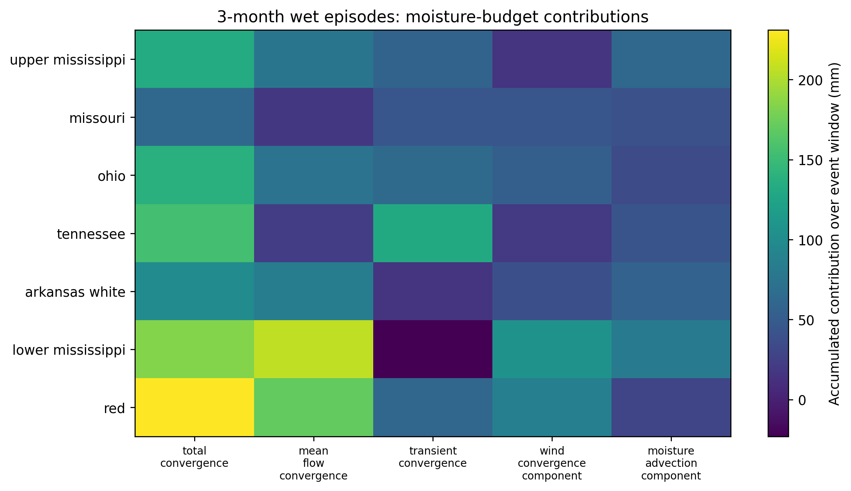
WET DECOMPOSITION | FIGURE
Where the wet moisture lands, term by term
Reading the grid
Brighter cells mark larger accumulated moisture supply during wet episodes.
Total convergence is largest in the bright Red and Lower Mississippi rows, the downstream end of the system.
Mean-flow convergence carries the southern basins; it is the dominant column for Lower Mississippi and Red.
Transient convergence is comparatively muted downstream (the dark Lower Mississippi cell) yet contributes upstream and in Tennessee.
These are accumulated totals over the window, not anomalies. The departure-from-normal signal is the wet anomaly bar chart two slides earlier.
Accumulated moisture-budget contributions over the 3-month wet window (mm), by basin (rows) and term (columns).
ERA5 moisture-budget analysis | Mississippi River wet and dry extremes
12

Slide 13
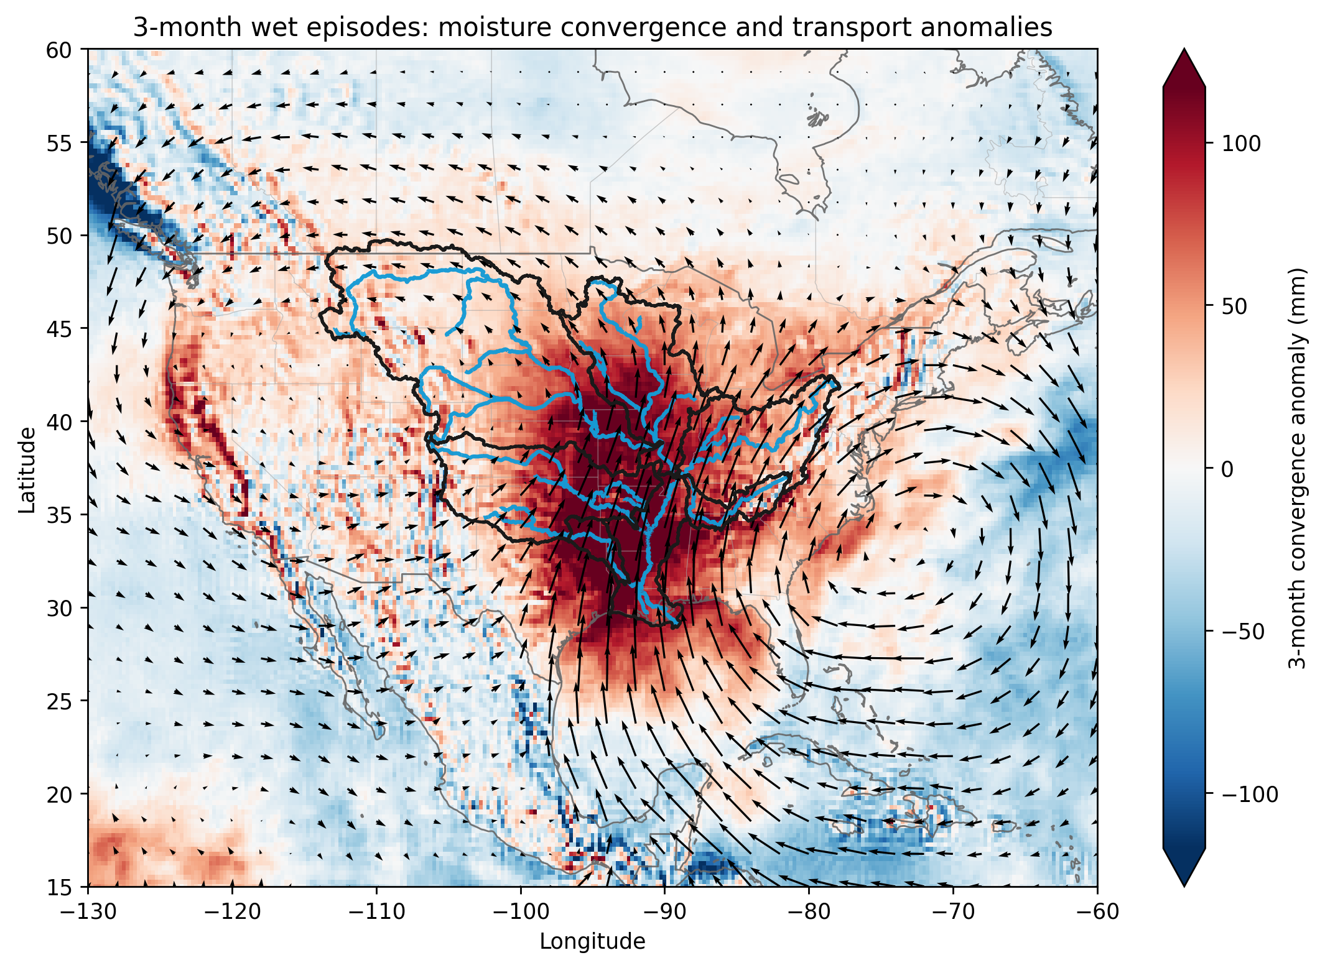
WET TRANSPORT | FIGURE
A Gulf-fed conduit converging on the basin
The geographic answer
A deep positive convergence core sits over the central and lower Mississippi, exceeding +100 mm.
Transport arrows surge northward off the Gulf of Mexico, funnelling moisture into the corridor.
A subtropical Atlantic circulation feeds that southerly inflow along its western flank.
Blue export anomalies over the eastern Pacific and the Northeast frame the basin surplus.
Extreme wet spells draw a coherent Gulf moisture stream that converges over the Mississippi, the interpretation the numeric tables alone could not supply.
Shading: 3-month convergence anomaly (mm). Arrows: anomalous vertically integrated vapour transport.
ERA5 moisture-budget analysis | Mississippi River wet and dry extremes
13

Slide 14
DROUGHT MECHANISM
A broad, system-wide failure of moisture supply
All seven negative
Total convergence anomalies are significantly negative in every basin over the 12-month drought window.
A year-long deficit is not the sum of random dry months. The atmosphere stays systematically less able to deliver moisture across the whole window. Red and Lower Mississippi fail hardest.
ERA5 moisture-budget analysis | Mississippi River wet and dry extremes
14

Slide 15
DROUGHT DECOMPOSITION
The same deficit, different regional causes
1
Weaker wind convergence
2
Mean vs transient split
3
Moisture advection
Negative across almost the entire system and statistically robust in all basins except Missouri. The largest deficits sit in Lower Mississippi and Red River.
Strong mean-flow deficits in the southern and eastern basins. In Upper Mississippi and Missouri the mean flow is weak; there the drought comes instead from strongly reduced transient convergence.
Strongly unfavourable in Ohio and Tennessee. Missouri even shows a positive advection anomaly, but it is overwhelmed by collapsing transient supply.
The same basin-wide deficit can arise from different blends of weaker mean circulation, reduced transient transport, and unfavourable advection in different tributaries. Drought is not spatially uniform.
ERA5 moisture-budget analysis | Mississippi River wet and dry extremes
15

Slide 16
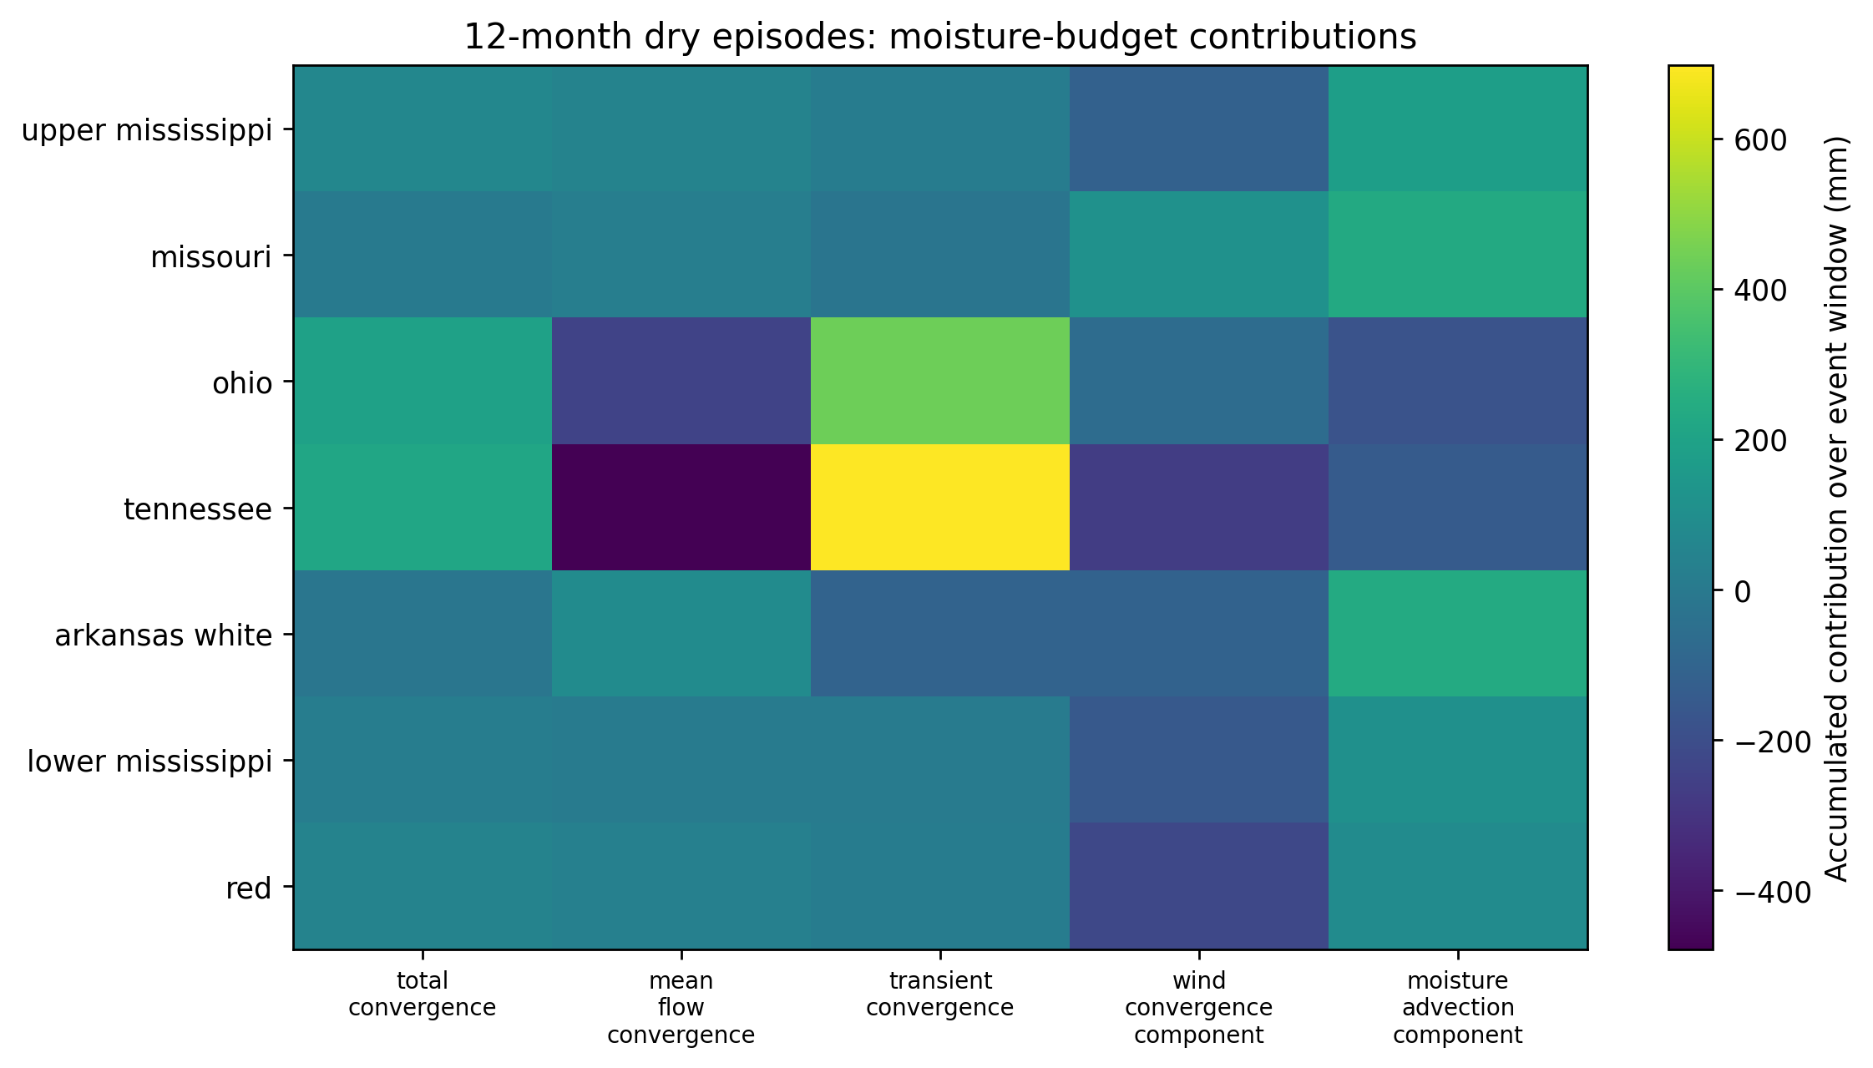
DROUGHT DECOMPOSITION | FIGURE
The competing terms behind a year-long deficit
Opposing columns
Mean-flow and transient terms pull hard against each other, most visibly in Tennessee and Ohio: deeply negative mean-flow set against strongly positive transient.
Wind-convergence contributions run negative in the far-downstream Lower Mississippi and Red rows.
Moisture advection is unfavourable in Ohio and Tennessee, yet positive in Missouri and Arkansas-White.
Absolute accumulated contributions blend climatology with the event, so read them alongside the all-negative convergence anomaly bar chart.
Accumulated contributions over the 12-month dry window (mm), by basin and term. Note the wider colour range than the wet grid.
ERA5 moisture-budget analysis | Mississippi River wet and dry extremes
16

Slide 17
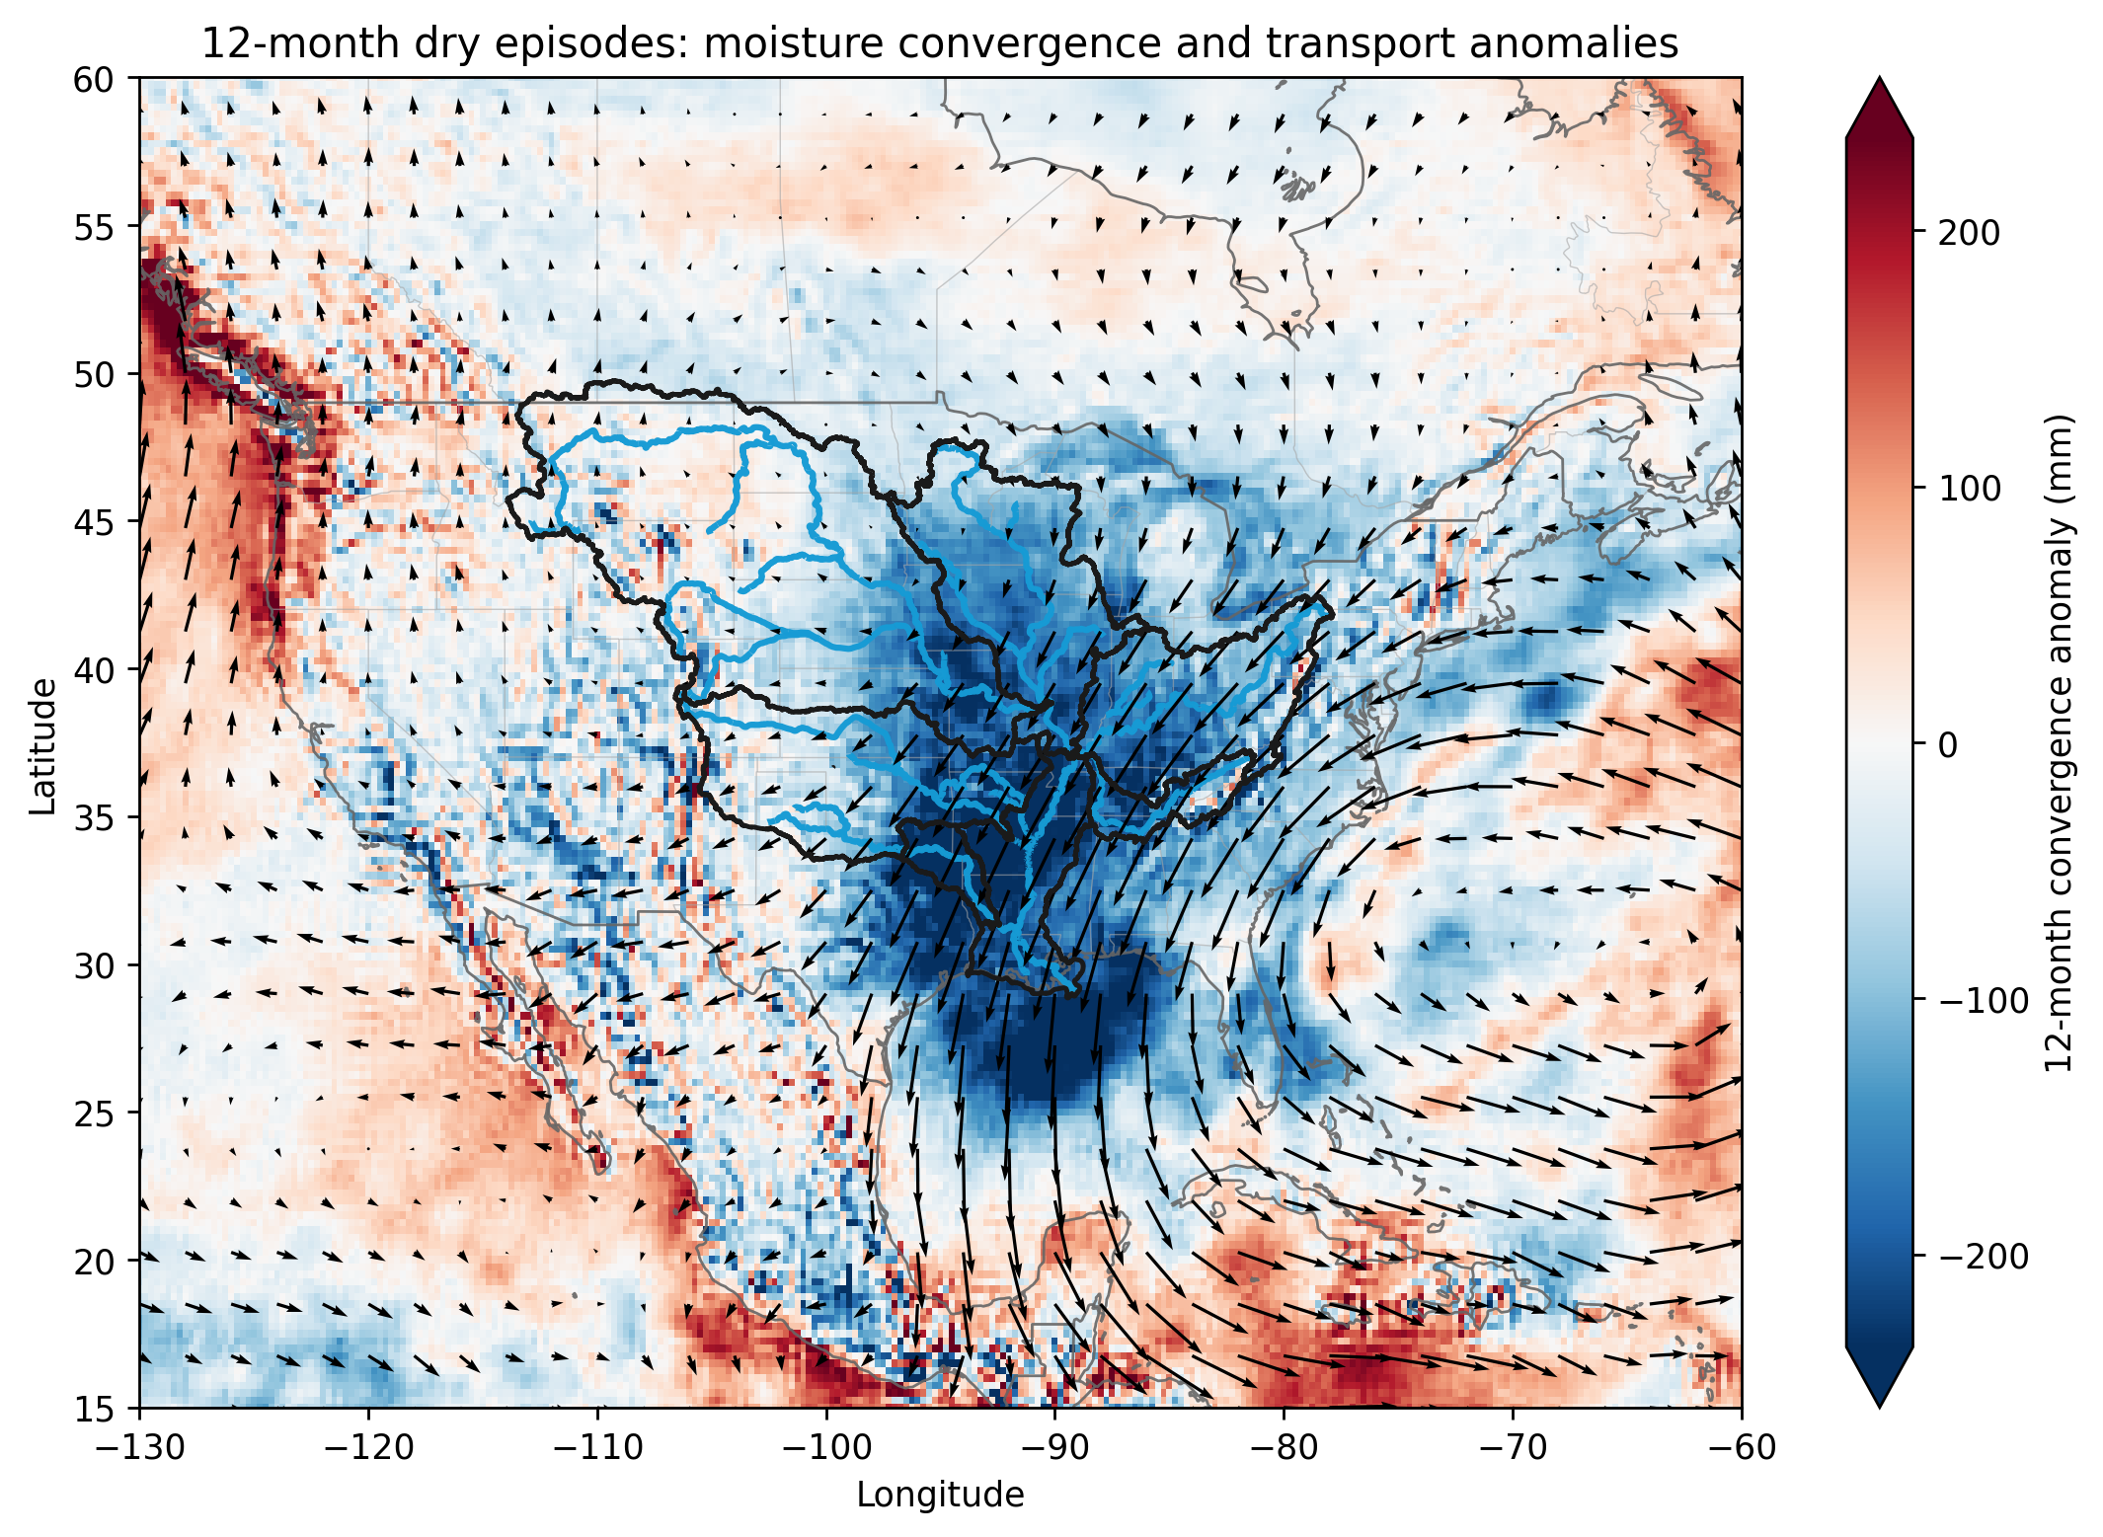
DROUGHT TRANSPORT | FIGURE
The Gulf pathway shuts down and reverses
Mirror of the flood
A broad negative convergence deficit blankets the basin, dropping below -200 mm over twelve months.
Transport arrows point southward out of the basin toward the Gulf, the reverse of the wet surge.
The Gulf inflow is suppressed and turns to net export across the corridor.
Positive anomalies ring the basin to the west, east and south.
Windows differ (12 months here versus 3 for the wet map), so the magnitudes are not directly comparable. Persistent drought is a large-scale reorganisation of transport, not merely local rainfall variance.
Shading: 12-month convergence anomaly (mm). Arrows: anomalous vapour transport.
ERA5 moisture-budget analysis | Mississippi River wet and dry extremes
17

Slide 18
TEMPORAL CHANGE
Fewer droughts; individual events no stronger
Frequency
Wet episodes barely move (about +11%, no formal test).
12-month dry episodes fall from 3.55 to 1.71 per decade, roughly a 52% drop.
Magnitude
Every early-versus-recent difference in P, E, P - E and convergence has a bootstrap interval spanning zero.
The signal is in event OCCURRENCE, not event intensity.
ERA5 moisture-budget analysis | Mississippi River wet and dry extremes
18

Slide 19
POST-1940 ANALOGS
Ranked extremes give the 1927 flood a modern reference set
Strongest wet convergence
Strongest drought deficits
1993 Upper Miss. +226 mm, Missouri +164 mm (Aug)
Lower Miss. strong episodes in 1991 and 1983
Red / Tennessee peaks in 2015, 2019 and early 2019
1963 Lower Miss. -523 mm, Red -558 mm (southern)
Upper Miss. deepest sustained deficit around 1976-1977
Missouri / Tennessee worst near 2012 and 2007
Method validation
The 1993 summer emerges independently as the largest Upper Mississippi and Missouri convergence anomaly in the record, exactly the year that dominates the basin-wide wet index. Drought and flood rankings both show strong regional structure: a basin-wide extreme does not demand identical dynamics in every tributary.
ERA5 moisture-budget analysis | Mississippi River wet and dry extremes
19

Slide 20
THE BRIDGE TO 1927
What ERA5 can and cannot say about the flood
ERA5 cannot reconstruct 1927 directly. What it provides is the atmospheric fingerprint of comparable modern wet sequences, and that is the physical interpretation the historical record cannot supply on its own.
1
Budget is trustworthy
2
Wet = system-wide convergence
Monthly P - E and convergence correlate at 0.95 and their means nearly close.
Extreme 3-month wet periods show positive convergence anomalies in every sub-basin.
3
Drought = supply failure
4
Mechanism varies by region
Persistent 12-month dry events show a basin-wide convergence deficit everywhere.
Mean flow leads, with transients and advection contributing differently by tributary.
Change is in frequency
The historical record shows how exceptional 1927 was.
ERA5 shows what atmosphere produces a sequence of that type.
5
Fewer droughts after 1990; individual-event magnitude shows no robust shift.
If the historical analysis shows the months before 1927 formed an exceptionally strong 3-month wet sequence across tributaries, the modern analogs imply it required a coherent, persistent moisture-supply anomaly, not a chance collection of unrelated storms.

