Slide 1
MOISTURE-BUDGET EVALUATION
Can six CMIP6 models reproduce the physics of Mississippi wet extremes?
The six parent models behind the HydroSource downscaled product, tested against ERA5 over the six contributing sub-basins.
6
66 yr
6
parent models
equal samples
sub-basins

Slide 2
HOW THE TEST IS BUILT
One yardstick for every model
Each dataset is scored on its own climatology, over equal-length records, so nothing is judged unfairly.
Own-climatology events
The six parent models
A wet event is a dataset's own top 5% of 3-month precipitation. Models and ERA5 are each measured against themselves.
ACCESS-CM2
BCC-CSM2-MR
CNRM-ESM2-1
Equal 66-year samples
ERA5 spans 1959 to 2024, the models 1949 to 2014. Both are 66 years, so event counts compare directly.
MPI-ESM1-2-HR
MRI-ESM2-0
NorESM2-MM
Supply, split by mechanism
Objectively chosen: these six ranked highest over the US across 66 tests (Ashfaq et al. 2022), the skill-screened parents of HydroSource.
At each wet peak we take the mean-flow moisture convergence and split it into a wind part and a moisture-advection part, per basin.
CMIP6 HydroSource vs ERA5 | wet-event moisture budget
2

Slide 3
WHAT THIS ANALYSIS COVERS
The monthly fields, not the daily product
This budget is computed on raw monthly model output. The forcing that VIC will use is a different, downscaled layer.
What was analyzed here
What forces VIC4L
Raw monthly CMIP6 precipitation and moisture transport, straight from each model. The moisture budget runs on these coarse monthly fields. No bias correction, no daily detail.
The HydroSource daily product (Kao et al. 2022): about 4 km, daily, 1980 to 2019, bias-corrected. Two downscaling methods (RegCM4, DBCCA) times two targets (Daymet, Livneh) give 4 versions per model, 24 forcings in all.
How to read the two layers
Two layers make the rain. The large-scale weather pattern decides how much moisture enters the basin and which sub-basins it feeds. The downscaled product then adds fine daily detail and corrects amounts to match observations, while keeping that large-scale pattern from the model. This analysis checks the large-scale pattern. It does not check the corrected daily amounts, the temperature, or which downscaled version is best.
CMIP6 HydroSource vs ERA5 | wet-event moisture budget
3

Slide 4
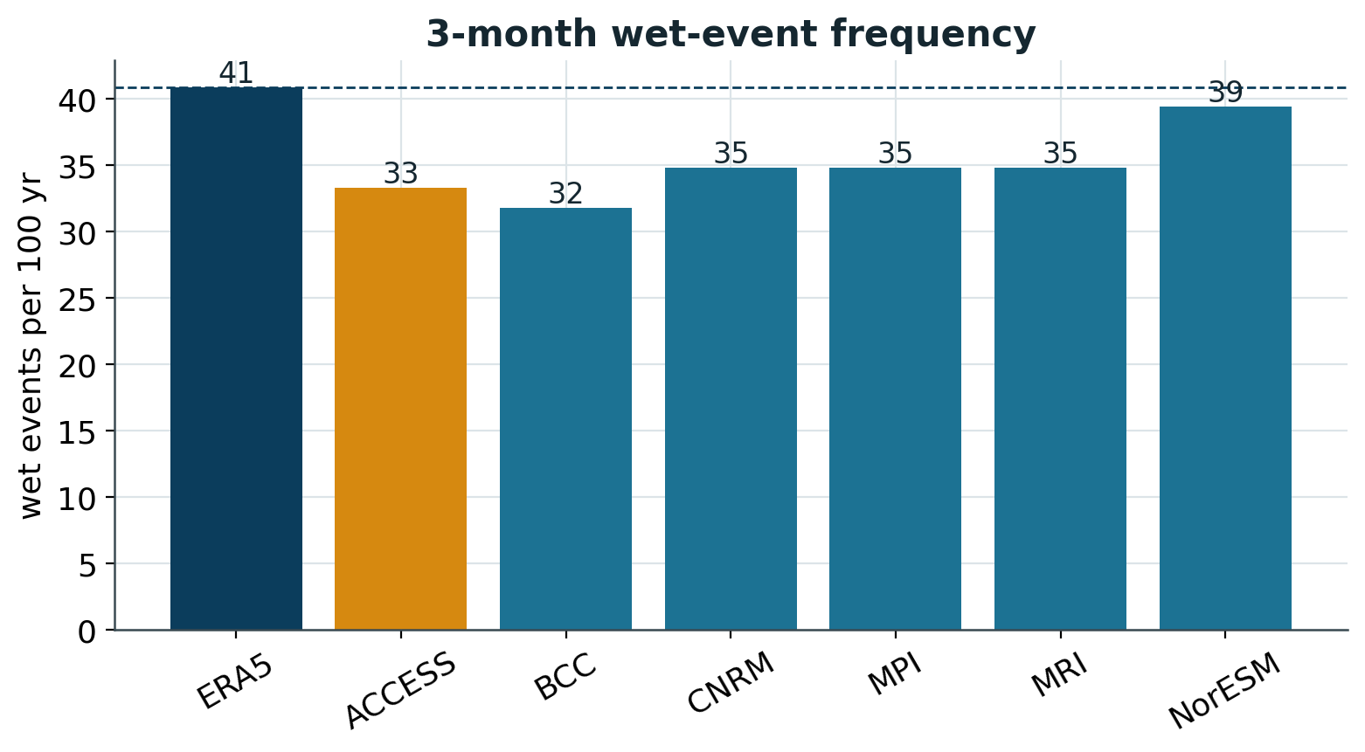
RESULT 1: HOW OFTEN
Wet events are a touch rarer in the models
Fewer events
ERA5 gives 41 per century. Models give 32 to 39, all a little below.
Same intensity
Peak strength (near the 98th percentile) and one-month duration match ERA5.
Correction fixes this
Count and amount are exactly what daily bias correction adjusts.
CMIP6 HydroSource vs ERA5 | wet-event moisture budget
4

Slide 5
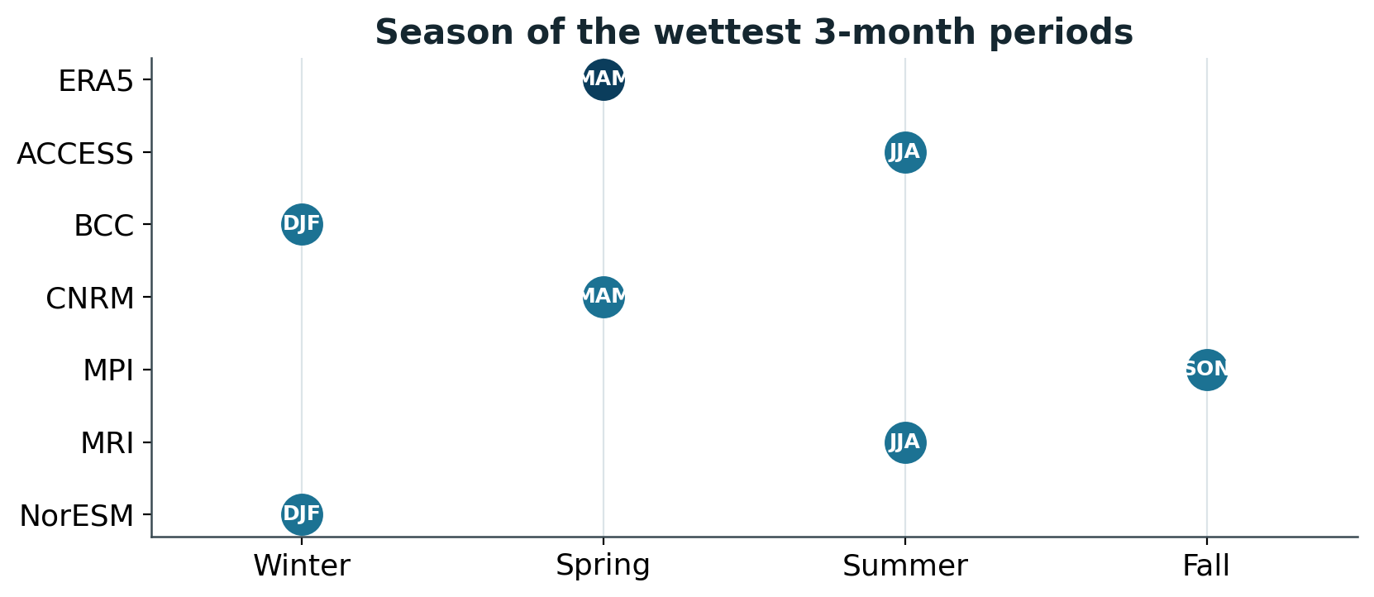
RESULT 2: WHEN
Only one model peaks in the right season
Timing is set by circulation
ERA5 peaks in spring. Only CNRM matches; the rest peak in summer, winter or fall.
Because season is driven by the large-scale flow, this bias can carry through into the forcing, unlike raw amount.
CMIP6 HydroSource vs ERA5 | wet-event moisture budget
5

Slide 6
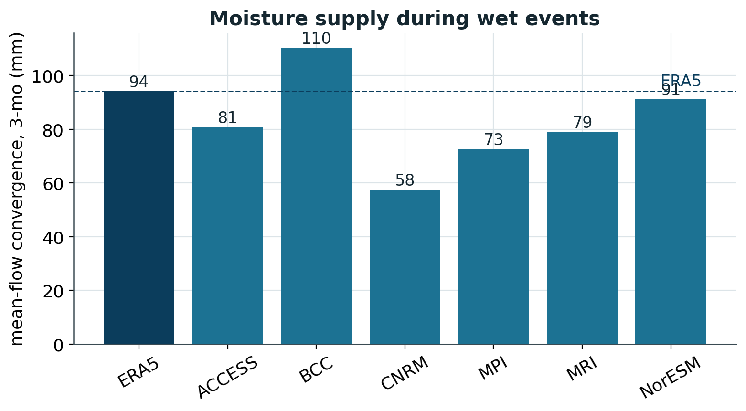
RESULT 3: THE SUPPLY
Every model brings the rain the right way
Right sign everywhere
All six supply wet events by mean-flow convergence, as ERA5 does (94 mm).
Mostly below ERA5
Supply spans 58 to 110 mm. Only BCC runs high; CNRM is lowest at 58.
Amount is not the weight
Correction removes this amount bias, so we weight on pattern instead.
CMIP6 HydroSource vs ERA5 | wet-event moisture budget
6

Slide 7
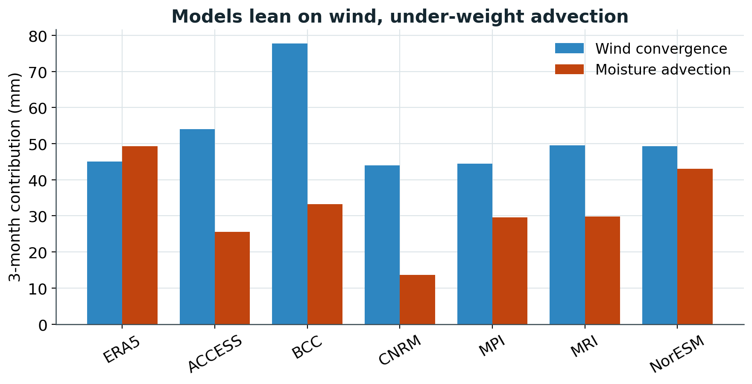
RESULT 4: THE MECHANISM
Models lean on wind, under-weight advection
Why this matters
ERA5 draws about equally on wind convergence (45 mm) and moisture advection (49 mm).
Every model leans on wind and gets too little from advection, as low as 14 mm in CNRM.
Advection is the term that grows under warming, so the future wet response may be under-scaled.
CMIP6 HydroSource vs ERA5 | wet-event moisture budget
7

Slide 8
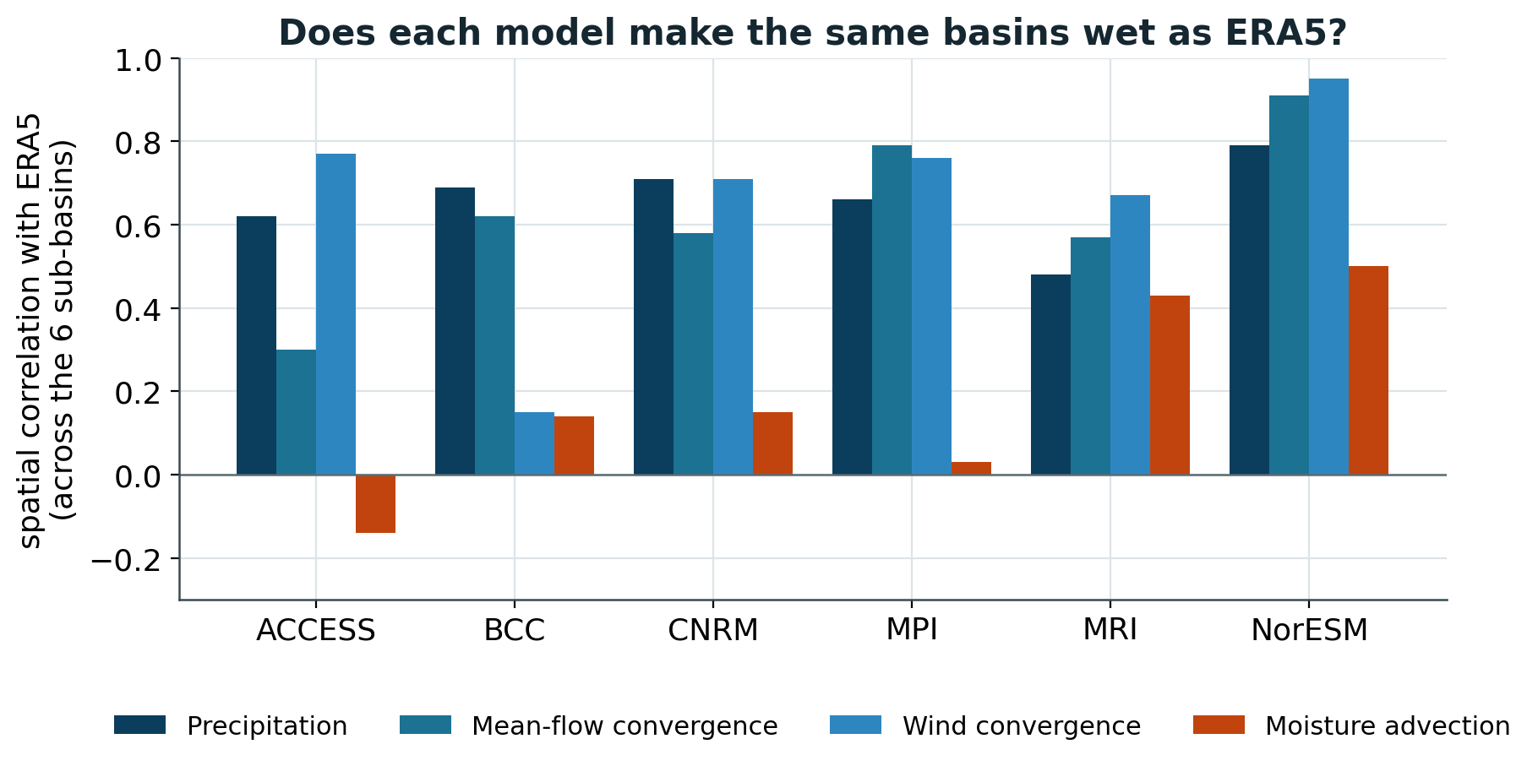
RESULT 5: SPATIAL CORRELATION
Do models make the same basins wet as ERA5?
Each bar is a spatial correlation: how well a model places high and low values in the same sub-basins as ERA5. 1.0 is a perfect match.
Precip and wind: fair
The pattern of precipitation and wind convergence broadly matches ERA5 (up to 0.95).
Advection: poor
The advection pattern matches ERA5 weakly or not at all (0.50 or less).
NorESM best, ACCESS worst
Convergence pattern reaches 0.91 for NorESM, only 0.30 for ACCESS.
CMIP6 HydroSource vs ERA5 | wet-event moisture budget
8

Slide 9
MODEL BY MODEL
Where each one stands against ERA5
NorESM2-MM
Closest to ERA5: supply 91 mm, best spatial match (0.91), near-ERA5 frequency. Wrong season (winter).
MPI-ESM1-2-HR
Strong spatial match (0.79); supply a bit low (73 mm). Wrong season (fall).
MRI-ESM2-0
Supply near ERA5 (79 mm) but weakest precipitation pattern; summer peak.
CNRM-ESM2-1
Only correct spring peak, but lowest supply (58 mm) and thinnest advection.
BCC-CSM2-MR
Over-supplies (110 mm); poorly placed wind pattern; winter peak.
ACCESS-CM2
Weakest spatial match (0.30) and thin advection; least like ERA5. Down-weight.
CMIP6 HydroSource vs ERA5 | wet-event moisture budget
9

Slide 10
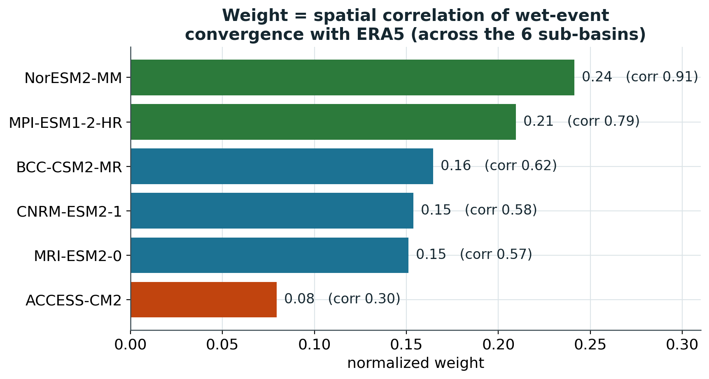
ONE NUMBER PER MODEL
The spatial correlation, turned into a weight
How well each model's wet-event convergence matches ERA5 across the basins, the mechanism that downscaling keeps.
What this number is
A spatial correlation across the six sub-basins: does the model make the same basins wet as ERA5? Higher means a closer match. It is the most telling single number, from 0.30 to 0.91.
Weights
Six basins and six models make this coarse. Show weighted and equal-weight results together, and treat it as a check, not a precise weighting.
CMIP6 HydroSource vs ERA5 | wet-event moisture budget
10

Slide 11
WHAT IT SAYS ABOUT THE VIC4L FORCING
Precip, Tmax, Tmin, wind: what is and is not tested
Precipitation
Which basins get the moisture, and when. Not the corrected daily amounts Hydrosource sees; those come from the target dataset.
Constrained: spatial pattern
Wind
The moisture flux carries the large-scale wind, but Hydrosource's surface wind comes from NARR, outside this analysis.
Weak, indirect
Tmax / Tmin
No temperature enters a moisture budget. Judge it from the model temperature evaluation and the corrected daily values.
Not constrained
24 configurations
The weight ranks the 6 models, not the 4 versions of each. Their spread needs a separate downscaled-product check.
Cannot rank
CMIP6 HydroSource vs ERA5 | wet-event moisture budget
11

Slide 12
WHAT TO CONCLUDE
Credible physics, weighted and bounded
Mechanism is right
Weight, then bound
A separate check remains
All six make wet extremes by basin-wide moisture convergence, as ERA5 does.
The large-scale physics the product inherits is credible, so the historical basis for a future response is sound.
Weight the models by spatial match: NorESM and MPI high, ACCESS low.
Report a weighted range, not a single number, and show the equal-weight case beside it.
This says nothing about corrected daily extremes, temperature, surface wind, or the 24 versions.
Each of those needs its own evaluation before the forcing is trusted end to end.
Hydrosource references: https://hydrosource2.ornl.gov/files/SWA9505V3/Reference/
CMIP6 HydroSource vs ERA5 | wet-event moisture budget
12

