Slide 1
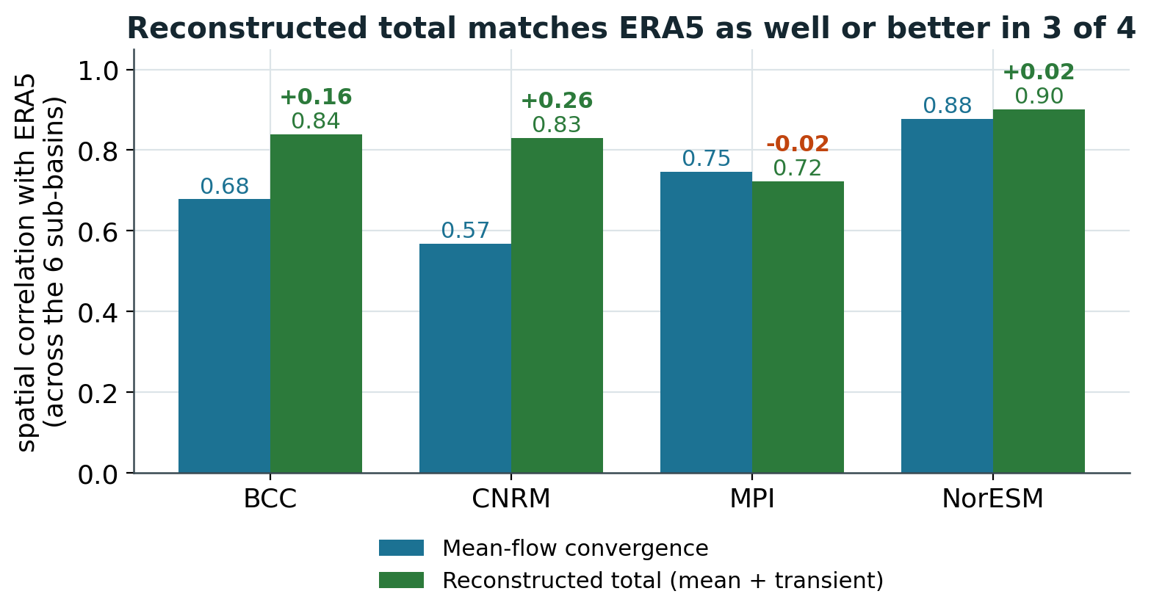
TRANSIENT CHECK
Adding storm transients keeps the pattern ERA5-like
Four of the six models have matched transient files. Reconstructed total is mean-flow plus transient convergence, scored against ERA5 across the six sub-basins.
3 of 4 improve
BCC and CNRM rise most, to 0.84 and 0.83. NorESM edges up to 0.90. MPI is essentially flat (0.75 to 0.72).
Transients fill other basins
Mean and transient patterns are anti-correlated, so storms add moisture where the mean flow is weak.
Secondary in size
Transient amplitude is 30 to 66% of the mean flow, same sign in 5 or 6 of the 6 basins.
CMIP6 HydroSource vs ERA5 | transient check
1

Slide 2
HOW THE TRANSIENT RESULT IS USED
A robustness check, not a reweighting
The transient term sharpens interpretation of the six-model weight. It does not replace it.
Primary weight stays mean-flow
The transient check covers four
Why not a mixed weight
The six-model weights use the spatial correlation of wet-event mean-flow convergence with ERA5, the 0.30 to 0.91 range. That diagnostic exists for all six models, so it stays.
Only BCC, CNRM, MPI and NorESM have transient files. ACCESS-CM2 and MRI do not have the 6-hourly CMIP6 data available to create the transient data.
Weighting four models by total convergence and two by mean flow would blend two diagnostics. With only four of six covered, it stays a mechanism check, outside the weighting.
Spatial correlation with ERA5, across the six sub-basins
Model | Mean-flow | Transient | Reconstructed total | Change
BCC-CSM2-MR | 0.68 | 0.29 | 0.84 | +0.16
CNRM-ESM2-1 | 0.57 | 0.77 | 0.83 | +0.26
MPI-ESM1-2-HR | 0.75 | 0.80 | 0.72 | -0.02
NorESM2-MM | 0.88 | 0.79 | 0.90 | +0.02
CMIP6 HydroSource vs ERA5 | transient check
2

